Slide 1
AI & Human Rights: new game, old rules?
Marriët Schuurman
-
Human Rights Ambassador of the Kingdom of the Netherlands

Slide 3
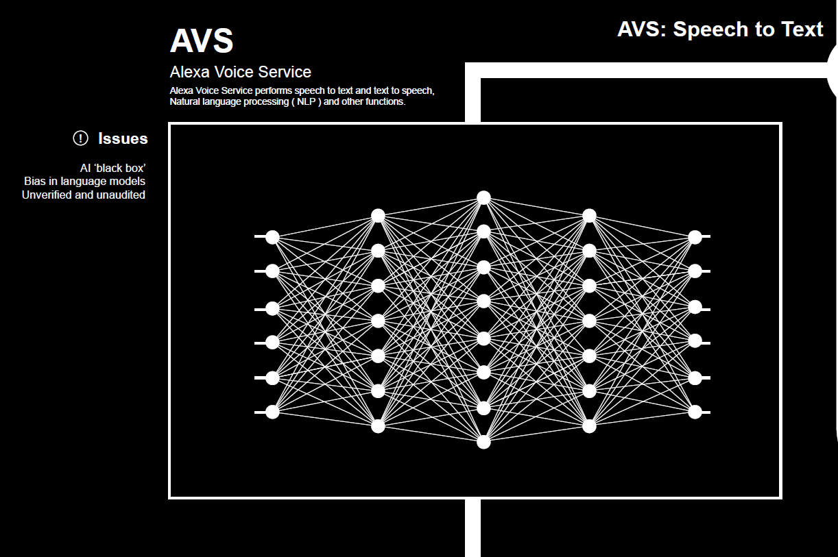

Slide 5
